Slide 1
What is programming?
Series of instructions to a computer to accomplish a task
Instructions must be written in a way the computer can understand
Programming languages are used to write programs

Slide 2
What is programming?
Once the code (language) of a program has been written, it must be executed (run, started).
You may need to type the name of the program to start it, or use a word like RUN and the name of the program (in the old days, anyway).

Slide 3
What is a programming language?
Set of commands that a computer has been “taught” to understand
Languages that look like “machine code” are called low level language
Other languages look like English (“high level,” e.g
JavaScript
C++ and many more

Slide 4
How do you write a program?
Decide what steps are needed to complete the task
Write the steps in pseudocode (written in English) or as a flowchart (graphic symbols)
Translate into the programming language
Try out the program and “debug” it (fix if necessary)

Slide 5
What is pseudocode?
List of steps written in English
Like the instructions for a recipe
Must be in the right sequence
Imagine saying “bake the cake” and then “mix it up”

Slide 6
Sample Pseudocode
Task: add two numbers
Pseudocode:
Start
Get two numbers
Add them
Print the answer
End

Slide 7
What does a flowchart look like?
The pseudocode from the previous slide would look like this as a flowchart:
Start
Print answer
Get 2 numbers
End
Add them

Slide 8
Elements of a Program
All programming languages have certain features in common. For example:
Variables
Commands/Syntax (the way commands are structured)
Loops
Decisions
Functions
Each programming language has a different set of rules about these features.

Slide 9
Variables
Variables are part of almost every program.
A variable is a “place to put data” and is usually represented by a letter or a word.
Ex:a=10 ➔ A
Variable names cannot contain spaces.
Some programming languages have very specific limits on variable names.
10

Slide 10
Variables
Usually there are several ways to put information into a variable.
The most common way is to use the equal sign (=).
X = Y + 7 means take the value of Y, add 7, and put it into X.
COUNT=COUNT + 2 means take the current value of COUNT, add 2 to it, and make it the new value of COUNT.

Slide 11
Variables
Sometimes you must specify the type of data that will be placed in a variable.
Here are some examples of data types:
Numeric (numbers of all kinds)
String (text, “strings of letters”)
Boolean (true/false)

Slide 12
Variables
Variables may be classified as global or local.
A global variable is one that can be shared by all parts of a program, including any functions or sub-programs.
A local variable is one that is used only within a certain part of the program, for example, only in one function or sub-program.

Slide 13
Commands/Syntax
Programming languages are truly languages.
They have rules about grammar, spelling, punctuation, etc.
You need to learn the rules of a programming language, just as you learned to speak and write English.

Slide 14
Loops
A loop is a repetition of all or part of the commands in a program.
A loop often has a counter (a variable) and continues to repeat a specified number of times.
A loop may also continue until a certain condition is met (e.g., until the end of a file or until a number reaches a set limit)

Slide 15
Decisions
You saw a flowchart symbol for decisions.
A program often needs to decide whether something is true or false in order to see which way to continue.
Programs often use IF (or IF THEN or IF THEN ELSE) statements to show a decision.

Slide 16
Decisions
An IF statement always has a condition to check, often a comparison between a variable and a number.
The IF statement also must specify what to do if the condition/comparison is true.
These instructions (for “true”) may come after the word THEN, or they may simply be listed.

Slide 17
Decisions
In an IF THEN statement, when the condition is false, the program simply ignores the THEN commands and continues to the next line.
In an IF THEN ELSE statement, commands are given for both the true and false conditions.

Slide 18
Functions
In most programming languages, small sub-programs are used to perform some of the tasks.
These may be called functions, subroutines, handlers, or other such terms.

Slide 19
Functions
A function generally gets information from the main program, performs some task, and returns information back to the program.
Functions follow the same rules of syntax, etc. as the main program.
JavaScript code is primarily made of a series of functions.

Slide 20
Hints for Writing Code
“Code” means writing the program in the appropriate language
Be sure the code is exact (spelling, capitals/lower case, punctuation, etc).
Write part of the code, try it, then write more.

Slide 21
Debugging
To “debug” means to try a program, then fix any mistakes.
Virtually no program works the first time you run it. There are just too many places to make errors.
When you are debugging a program, look for spelling and punctuation errors.
Fix one error at a time, then try the program again.

Slide 22
Self-Check
A computer program is…
A series of instructions to accomplish something
A TV show
Written in Egyptian hieroglyphics
Can be written any way you want to

Slide 23
Self-Check
A computer program is…
A series of instructions to accomplish something
A TV show
Written in Egyptian hieroglyphics
Can be written any way you want to

Slide 24
Self-Check
To “compile” a program means to…
Translate it into English
Translate it into binary code
Pile up the punch cards used for the program
Run the program as it was written

Slide 25
Self-Check
To “compile” a program means to…
Translate it into English
Translate it into binary code
Pile up the punch cards used for the program
Run the program as it was written

Slide 26
Self-Check
Pseudocode is…
The program as it is written in a programming language
The results of a program that makes secret codes
The logic of a program written in English
The logic of a program shown in a chart

Slide 27
Self-Check
Pseudocode is…
The program as it is written in a programming language
The results of a program that makes secret codes
The logic of a program written in English
The logic of a program shown in a chart

Slide 28
MATLAB- Chapter 1 -2 MATLAB is normally operated from within the MATLAB integrated development environment (IDE).

Slide 29
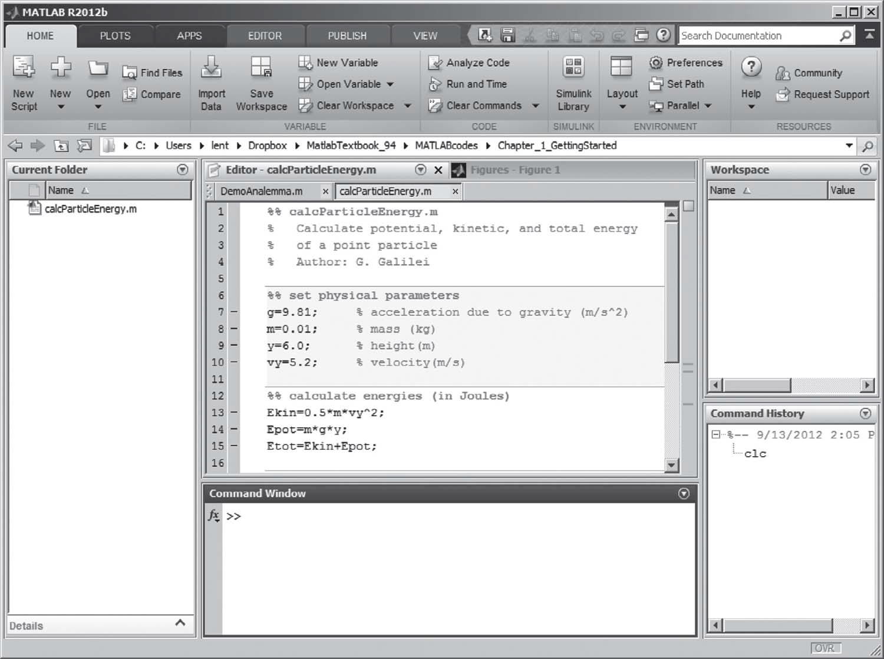

Slide 30
Variable assignment statements
<variable name>=<expression>;
a=5*x;
c= sin(x) +exp(x)
Variable names ➔ case-sensitive and must begin with a letter. The name must be composed of letters, numbers, and underscores; do not use other punctuation symbols.
xinit --------------------- okay
VRightInitial ------------okay
4You2do ----------------- not okay
Start-up ------------------ not okay
vector%1----------------- not okay
Vextor_1----------------- okay

Slide 31
Variable types:
>> a=4; % class double ..8bytes
>> fname='Robert'; % class char …..2* num of char( 1byte)
>> temperature=101.2; % class double …8bytes
[+ve: (0-2^64 ), -ve: ( -2^32 2^32)]
>> isDone=true; % class logical (1 byte)
Numbers and functions
Large and small numbers are represented in scientific notation: 6.23124567*10^23= 6.23124567e +23
-1.6031*10^-19 = -1.6031e-19
Complex number : 2+2i
Operations: +, -, *, /, ^
Functions: sin(x), cos(x), exp(x), log(x), abs(x), qrt(x), round(x), ciel(x), floor(x), rand(x)…Page (10)

Slide 32
Simple MATLAB scripts
Block Structure:
Header block: % name of the program file…. % What does the program do … % name of the programmer…
Set of the input parameters with % comment
Set of calculations
Display or plot the results
Problem: write a program to compute the potential, Kinetic energy and the total energy of a point particle near the earth surface.

Slide 33
Variable workspace shows the currently used variables
Clear a v g: clears the variables a v g from the workspace
Clear all: clears all variables from the workspace
Who: lists the currently defined variables
Whos: displays a detailed list of defined variables
Save: saves the current workspace to the file called matlab.mat
Load: loads variables saved in matlab.mat into the current workspace

Slide 34
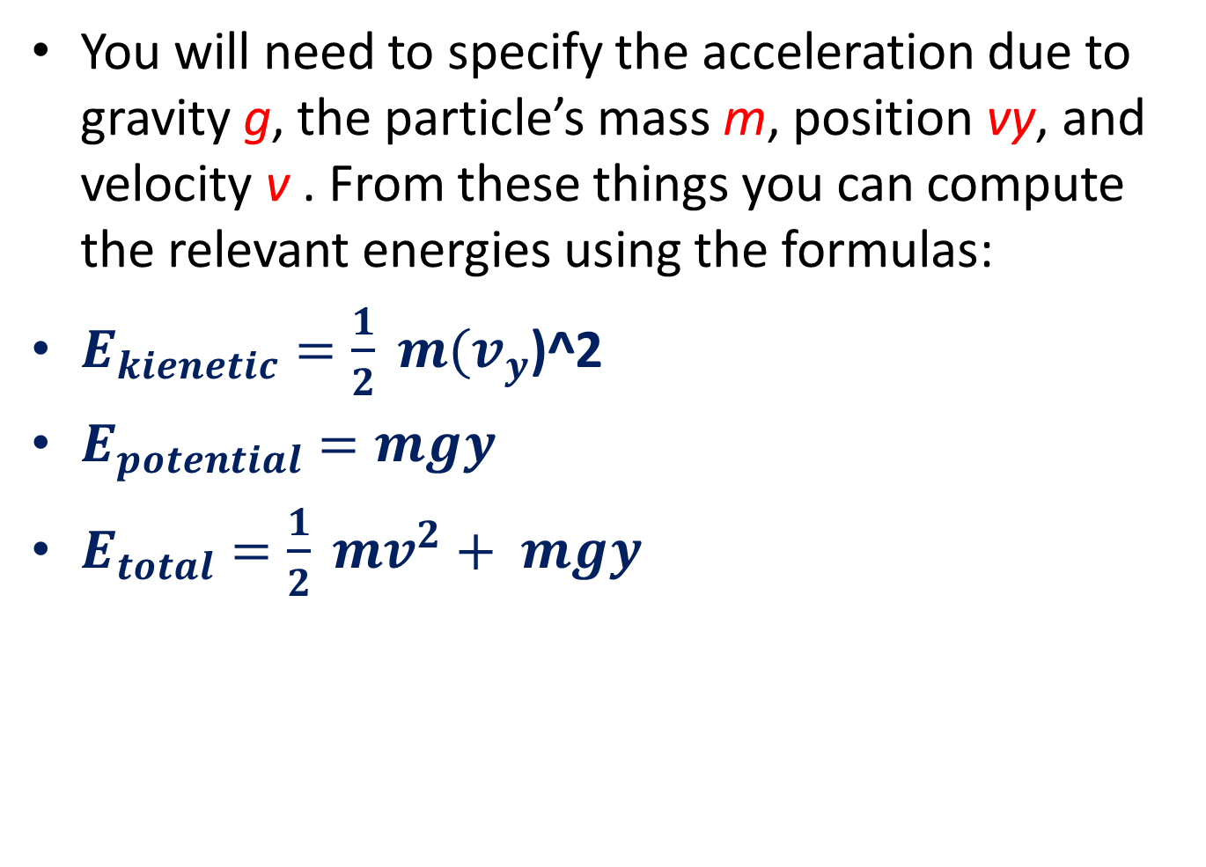
Problem: write a program to compute the potential, Kinetic energy and the total energy of a point particle near the earth surface.
You will need to specify the acceleration due to gravity g, the particle’s mass m, position vy, and velocity v . From these things you can compute the relevant energies using the formulas:
$E_{kienetic}=\frac{1}{2} m(v_{y}$)^2
$E_{potential}=mgy$
$E_{total}=\frac{1}{2} mv^{2}+ mgy$

Slide 35
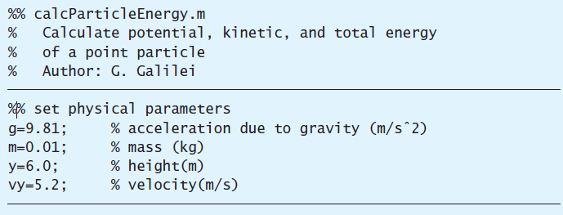
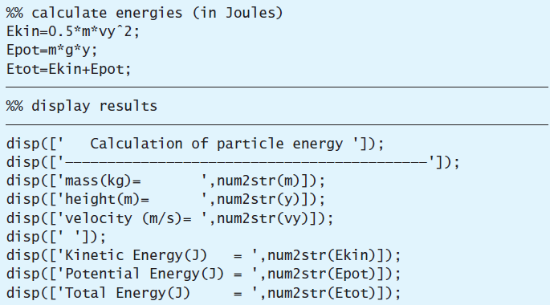

Slide 36
Calculation of equivalent resistance
Write a program to calculate the equivalent resistance and the total current for three resistors that are connected once in series and then in parallel. Vin =20 v, R1 = 1 Mohm, R2 = 10 Mohm, R3=30 Mohm
Req_series= R1+R2+R3
1/Req_parallel= (1/R1 + 1/R2+ 1/R3 )
Total current =Vin/Req

Slide 37
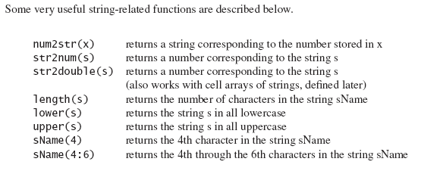
Chapter 2 Strings and Arrays
String can be entered directly by using single quotes. Ex: firstname= ’sam’;
Strings can be concatenating,
<new string>=[<string1>, <string2>,…]
List strings={ string1 ; string2;string2}

Slide 38
disp : used to display strings and data.
Input: Prompt user for input and assign it to variable, ‘s’ is an option for string.
menu: return GUI menue and return a numerical value.
Ex:
C= Input(‘Enter your name’ , ‘s’) % C is a string
A= Input(‘Enter your id ’) % A is a numerical value 1, 2…
B= Menu(‘select’, ‘Math’, ‘Science’, MATLAB’) % B is 1 or 2 or 3
x= 10; y=20;
disp ( x) % return 10 but disp (x,y) return error, too many arguments
disp ([x, y]) % return 10, 20 easy but limited

Slide 39
Vector: one dimensional array of data or strings
x=[ 10, 20, 30] or x= [ 10 20 30], % return one row
y=[ 1; 2; 3] % return one column
Z=[x, y] % concatenate arrays z[10, 20, 30, 1,2,3]
Vector operations ( add, sub, div, mul, transpose)
ones(1,5) % returns 1 1 1 1 1
zeros(1,3) % returns 0 0 0
rv=rand(1,5); disp(rv) % returns 5 random values.
Rv=randi(3,1,5) % generate 5 random between 1 and 3
The followings create arrays:
Var= linspace ( initial value, final value, number of point)
Var =Initial value: step: final value % returns array of data
Var1= function(Var) % implement function on array

Slide 40
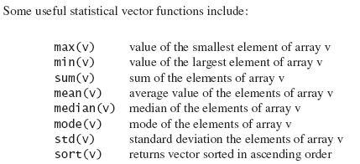
Statistical functions

Slide 41
Scaler Multiplication:
Element-by-element multiplication or division of vectors with vectors
c=v1.*v2 v1 and v2 must be the same size
and shape
c=v1./v2 v1 and v2 must be the same size
and shape
Element-by-element exponentiation c=v.^2
Element-by-element requires ‘dot’ :
.* ./ .^

Slide 42
Vector-vector multiplication
If (and only if) two arrays have a size compatible with matrix multiplication, then MATLAB interprets a*b as matrix multiplication.
>> v=[1; 2; 3];
>> w=[4; 5; 6];
>> y=v*w'
y =
4 5 6
8 10 12
12 15 18
MATLAB
Math
outer product
direct product

Slide 43
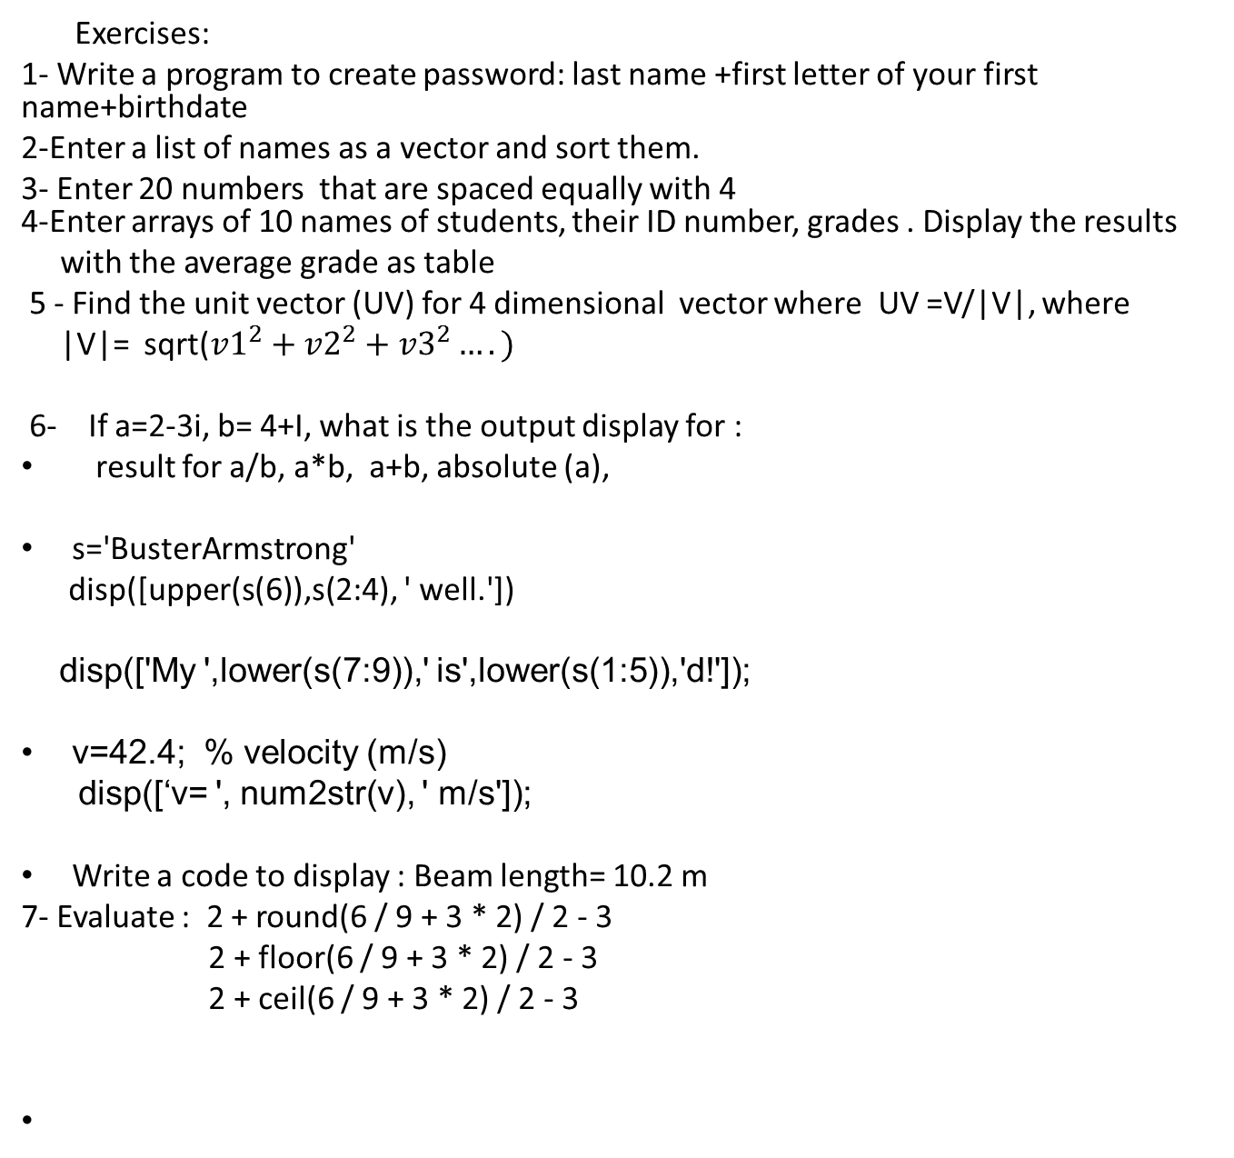
Exercises:
1- Write a program to create password: last name +first letter of your first name+birthdate
2-Enter a list of names as a vector and sort them.
3- Enter 20 numbers that are spaced equally with 4 4-Enter arrays of 10 names of students, their ID number, grades . Display the results
with the average grade as table
5 - Find the unit vector (UV) for 4 dimensional vector where UV =V/|V|, where
|V|= sqrt(${v1}^{2}+{v2}^{2}+{v3}^{2}….)$
6- If a=2-3i, b= 4+I, what is the output display for :
result for a/b, a*b, a+b, absolute (a),
s='BusterArmstrong'
disp([upper(s(6)),s(2:4), ' well.'])
disp(['My ',lower(s(7:9)),' is',lower(s(1:5)),'d!']);
v=42.4; % velocity (m/s)
disp([‘v= ', num2str(v), ' m/s']);
Write a code to display : Beam length= 10.2 m
7- Evaluate : 2 + round(6 / 9 + 3 * 2) / 2 - 3
2 + floor(6 / 9 + 3 * 2) / 2 - 3
2 + ceil(6 / 9 + 3 * 2) / 2 - 3

